Slide 1
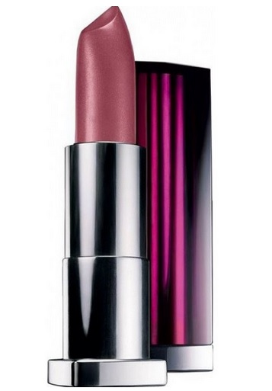
HomeLips
Shop of Natural Lipstickt

Slide 2
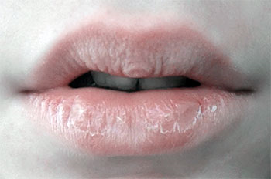
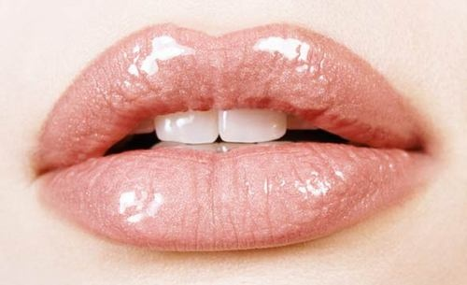
Problem Solution

Slide 3
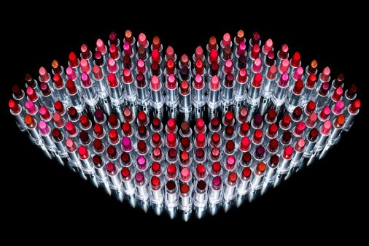
Solution
Our website of natural lipstick is the solution, all the problems associated with the lips..

Slide 4
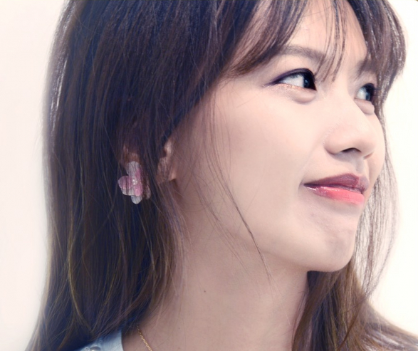
Lecture hall
They are mostly women from 16-37 years old. But our goods fit many layers of society

Slide 5
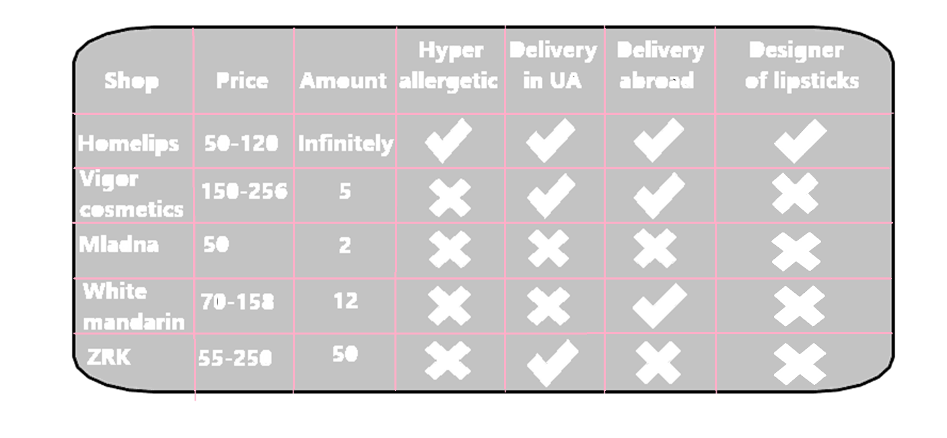
Competition in our area

Slide 6

Instagram- HomeLips Facebook- Home Lips

